Slide 1
Induction to DSP
By Yonghao Wang
Jan/2018

Slide 2
What do we cover in DSP module
About 5% Computer System
  Memory, CPU, I/O, Bus system.
About 5% Digital (Audio) Networking
  OSI model, TCP/IP, Audio over IP, AES67
About 90% Digital (Audio) Signal Processing
  Digital filter
  Spectrum Analysis
  Basic digital audio effects
by Yonghao Wang

Slide 3
Module Information
Every week two lectures
  Lecture Theory based + Lecture interactive based
Two 2 hours Laboratory/Tutorial
DSP Teaching Team
  Yonghao Leo Wang yonghao.wang@bcu.ac.uk;
  Sam Smith Samuel.Smith@mail.bcu.ac.uk;
  Spyridon Stasis Spyridon.Stasis@bcu.ac.uk;
  Nick Jillings Nicholas.Jillings@mail.bcu.ac.uk ;
“Flipped Learning!”
by Y.Wang 2010
Notes:
预习：preparation
复习：Review

Slide 4
Additional network labs
Networking lab tutors
  Dalia El Banna Abdelghany Ashmawy <Dalia.Elbanna@mail.bcu.ac.uk>;
  Yangyang Song <Yangyang.Song@mail.bcu.ac.uk>;
Week 2 (30/1/2017) and Week 3 (06/02/2017) at Computer network Lab MP162/MP163
by Yonghao Wang

Slide 5
Assessments
One Assessment
Coursework – 100%
  Report on laboratory work and design and implementation of digital audio signal processing algorithms.
by Y.Wang
Notes:
What are assessments

Slide 6
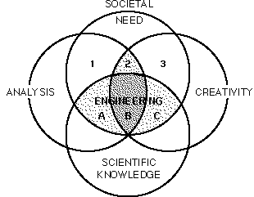
DSP – engineering approach
Philosophy
ART
by Yonghao Wang
Notes:
http://www.me.utexas.edu/~srdesign/paper/
Professional Responsibility The Role of Engineering in Society Nov, 5, 2010 S.P. Nichols and W.F. Weldon

Slide 7
What is Signal Processing?
Signal in
Processing
Signal out
(Analog or Digital)
(Analog or Digital)
Operation, Transformation
Example of Signals:
  Analog: Speech, Music, Photos, Video, radar, sonar, …
  Discrete-domain/Digital:
    digitized speech, digitized music, digitized images, digitized video, digitized radar and sonar signals,…
    stock market data, daily max temperature data, ...
by Y.Wang 2007

Slide 8
What is Digital Signal Processing?
Digital Signal in
Digital Processing
Digital Signal out
Operation, Transformation performed on digital signals
(using a computer or other special-purpose digital hardware)
But what about analog signals?
Analog Signal
in
Analog-to-
Digital (A/D)
Conversion
Digital-to- Analog (D/A)
Conversion
Digital Processing
by Y.Wang 2007
Notes:
Digital means:
Time discrete, value only exist at a point of time. Infinitesimal
Value with limited precision.

Slide 9
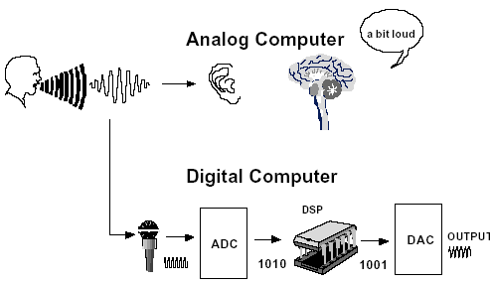
Signal Processing Examples
Why Go Digital??
by Y.Wang 2007

Slide 10
Acquired Skills
Knowledge of Computer architectures.
Knowledge of Audio networking.
Essential Engineering Mathematics.
Programming using Matlab.
Engineering Methodology and problem solving.
by Y.Wang 2007

Slide 11
DSP – ‘STUDY MAP’
DIGITAL FILTERS
OTHER TOPICS
SPECTRAL
ESTIMATION
DFT/FFT
OPTIMIZED DESIGN
WINDOW METHODS
IMPULSE INVARIANT
BILINEAR TRANSFORM
PARKS-McCLELLAN
(REMEZ EXCHANGE)
ANALOG FILTERS
BUTTERWORTH
CHEBYSHEV
ELLIPTIC
IIR
FILTERS
FIR
FILTERS
PROTOTYPES
S - PLANE
CONTINUOUS-TIME
Z – PLANE
DISCRETE-TIME SYSTEMS & SEQUENCES
by Y.Wang 2007

Slide 12
The End
Questions?
by Y.Wang 2008

